Slide 1
Legality, Ownership, Risks
CSCI 601-471/671 (NLP: Self-Supervised Models)
https://self-supervised.cs.jhu.edu/sp2024/

Slide 2
But first …
Open this link on your phone: pollev.com/danielkhashabi994
We will use this for collecting your votes!
Legality: https://www.youtube.com/watch?v=G08hY8dSrUY&ab_channel=LegalEagle

Slide 3
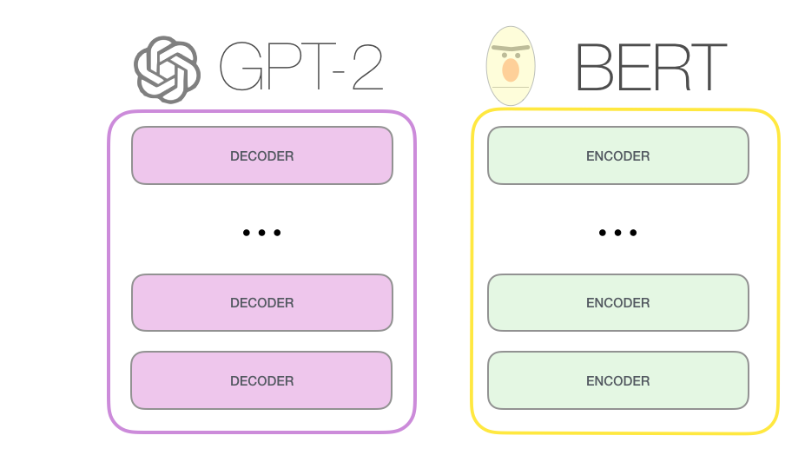
Large Language Models
[Bengio et al. ‘04, Peters et al. ‘18, Raffel et al. ‘20, Brown et al. ’20, many others]
Notes:
Need examples that shows how language models can fail in a variety of setups and generate things that may be problematic.

Slide 4
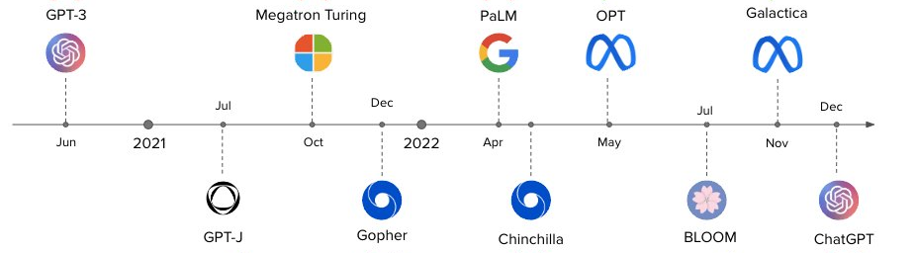
Large Language Models since GPT3
[Slide from Nazneen Rajani]

Slide 5
Scaling Self-Supervised Models
Scaling models generally improves their performance!
Notes:
These are some applications of language understanding for the context, and many of these have seem performance improvements in the past few years due to advent of deep learning.
So much so that some people got the impression that AI systems are closing in on human intelligence and …
Under the hood, these improvements are due to new developments on how neural networks are supervised with freely-available data, such as raw web text.
To be more concrete,
- self-supervised learning → gives some level of generality, but not enough
- increasingly large pre-training data
- increasingly larger models
Progresses are made, but we have a long way to go:
- LMs have an understanding of language structure → making it a useful representation tool
We need more:
- must generalize to many new tasks with essentially no retraining
- explaining, rationalizing and understanding the decisions
- imagining possible alternatives that haven’t happened yet
- planning actions for future
- models that actively revise their knowledge/decisions based on the feedback of their environment (and that includes both successes and failures)
- sharing our social and ethical values …
So in order to introduce such attributes we need a lot of work and progress to capture these.
- Tasks that we want to solve They are hard to control
During my PhD, I have taken several steps toward this broader goal, along these three methodological directions:
- ….
Eval
Repr
Symbolic
In this talk, I am going to focus on three projects specifically:

Slide 6


Scaling Self-Supervised Models
Scaling models generally improves their performance!
Larger pre-training datasets
cheap freely-available text
1GB
10GB
10TB
Notes:
These are some applications of language understanding for the context, and many of these have seem performance improvements in the past few years due to advent of deep learning.
So much so that some people got the impression that AI systems are closing in on human intelligence and …
Under the hood, these improvements are due to new developments on how neural networks are supervised with freely-available data, such as raw web text.
To be more concrete,
- self-supervised learning → gives some level of generality, but not enough
- increasingly large pre-training data
- increasingly larger models
Progresses are made, but we have a long way to go:
- LMs have an understanding of language structure → making it a useful representation tool
We need more:
- must generalize to many new tasks with essentially no retraining
- explaining, rationalizing and understanding the decisions
- imagining possible alternatives that haven’t happened yet
- planning actions for future
- models that actively revise their knowledge/decisions based on the feedback of their environment (and that includes both successes and failures)
- sharing our social and ethical values …
So in order to introduce such attributes we need a lot of work and progress to capture these.
- Tasks that we want to solve They are hard to control
During my PhD, I have taken several steps toward this broader goal, along these three methodological directions:
- ….
Eval
Repr
Symbolic
In this talk, I am going to focus on three projects specifically:

Slide 7
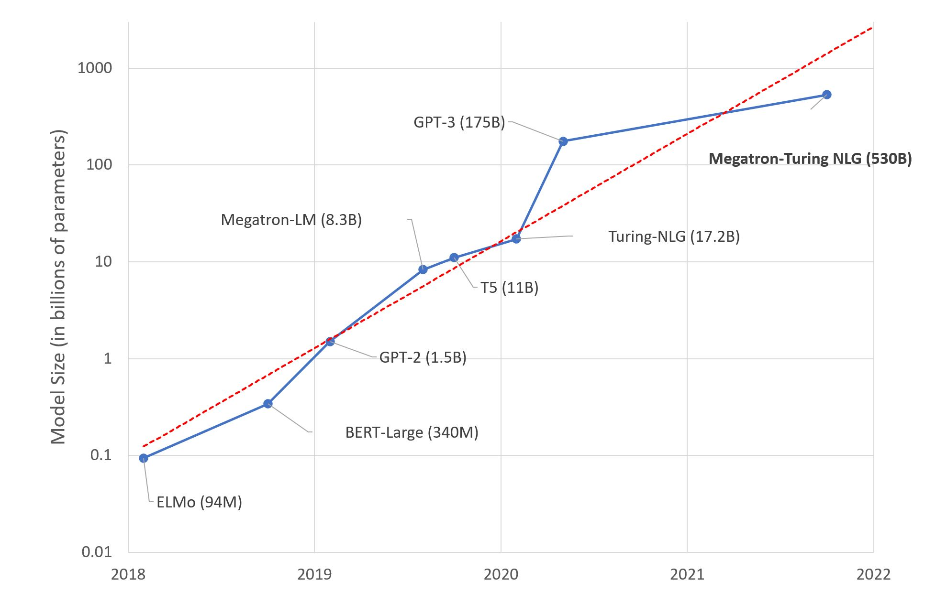
Scaling Self-Supervised Models
Scaling models generally improves their performance!
Larger pre-training datasets
Larger models
Notes:
These are some applications of language understanding for the context, and many of these have seem performance improvements in the past few years due to advent of deep learning.
So much so that some people got the impression that AI systems are closing in on human intelligence and …
Under the hood, these improvements are due to new developments on how neural networks are supervised with freely-available data, such as raw web text.
To be more concrete,
- self-supervised learning → gives some level of generality, but not enough
- increasingly large pre-training data
- increasingly larger models
Progresses are made, but we have a long way to go:
- LMs have an understanding of language structure → making it a useful representation tool
We need more:
- must generalize to many new tasks with essentially no retraining
- explaining, rationalizing and understanding the decisions
- imagining possible alternatives that haven’t happened yet
- planning actions for future
- models that actively revise their knowledge/decisions based on the feedback of their environment (and that includes both successes and failures)
- sharing our social and ethical values …
So in order to introduce such attributes we need a lot of work and progress to capture these.
- Tasks that we want to solve They are hard to control
During my PhD, I have taken several steps toward this broader goal, along these three methodological directions:
- ….
Eval
Repr
Symbolic
In this talk, I am going to focus on three projects specifically:

Slide 8
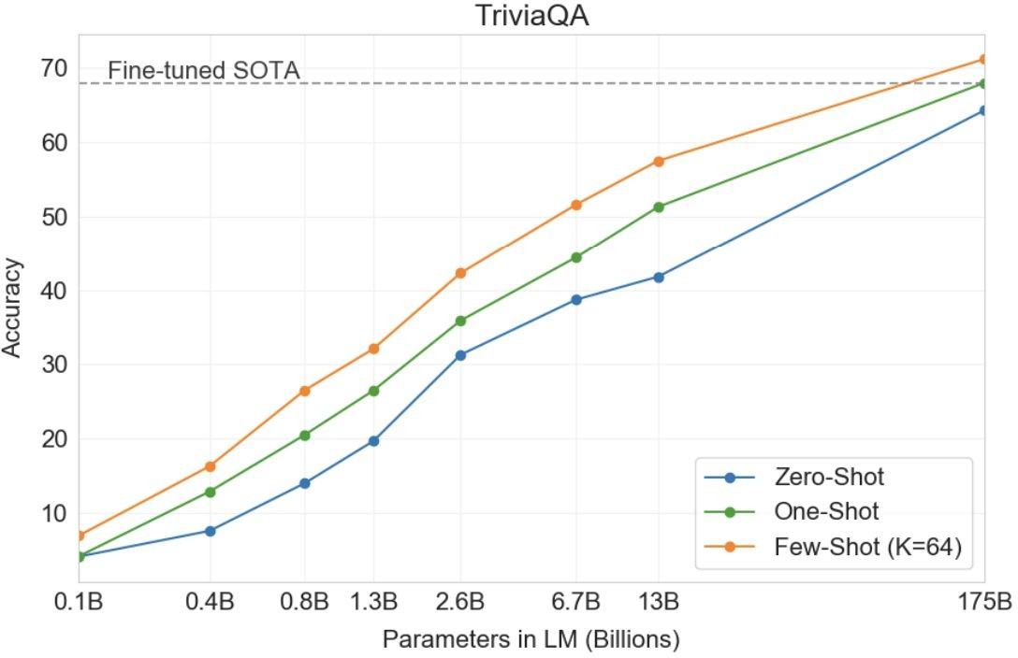
Scaling Self-Supervised Models
[ Brown et al. 2020. “Language Models are Few-Shot Learners” ]

Slide 9
ChatGPT: LM optimized for Dialogue
Days ago ….
170B model
Built on top of GPT3.x
Fine-tune to respond to interactive dialogue
https://openai.com/blog/chatgpt/

Slide 10
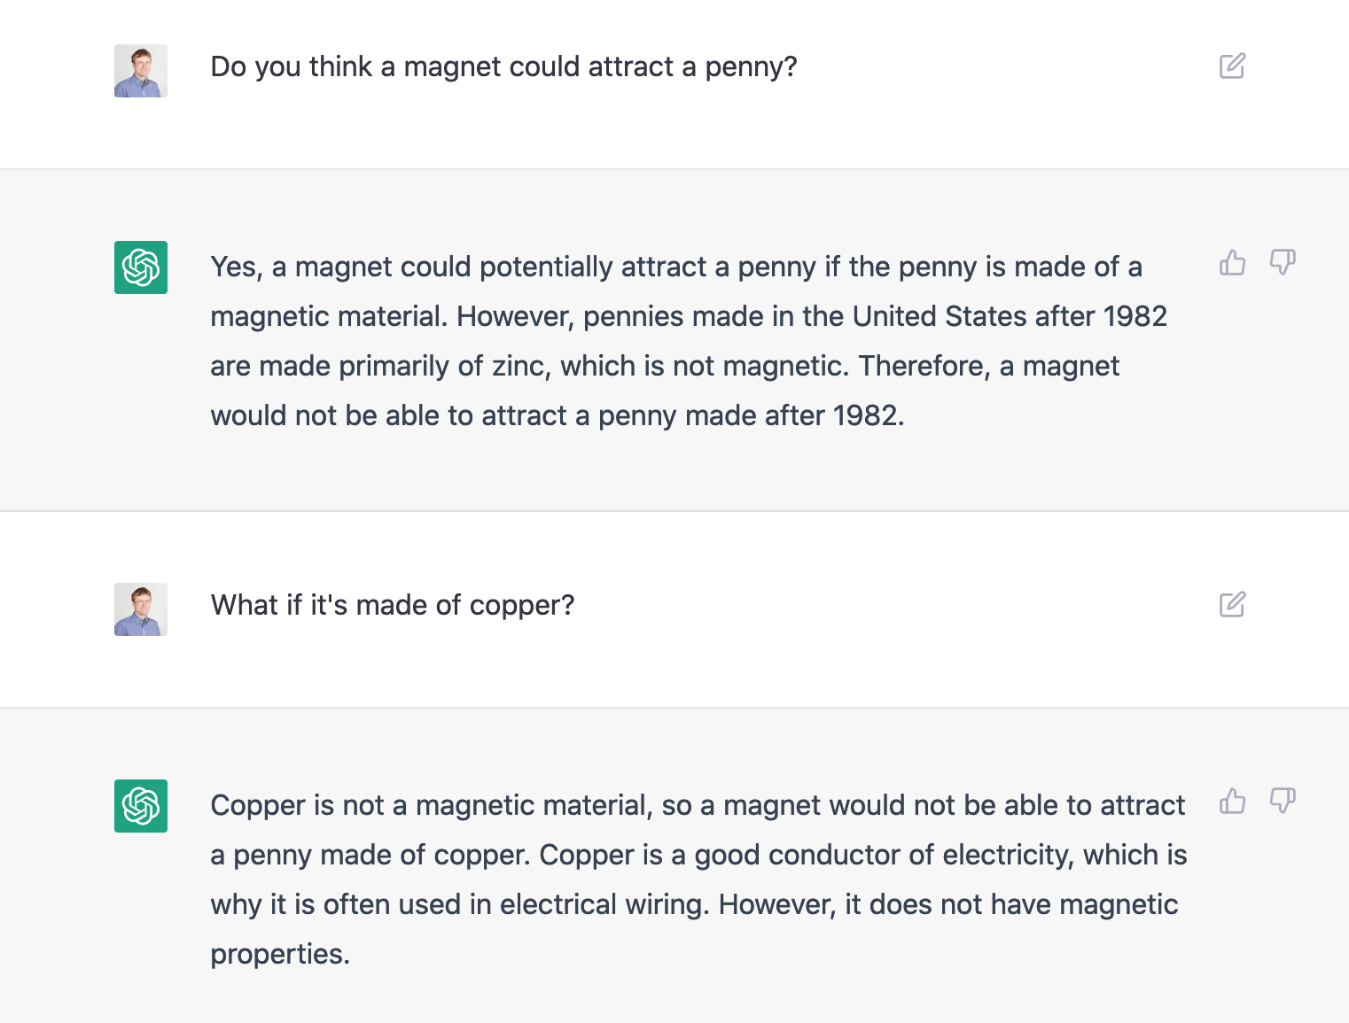

Slide 11

"Write George Washington's farewell address as if it was delivered by a pirate"

Slide 12
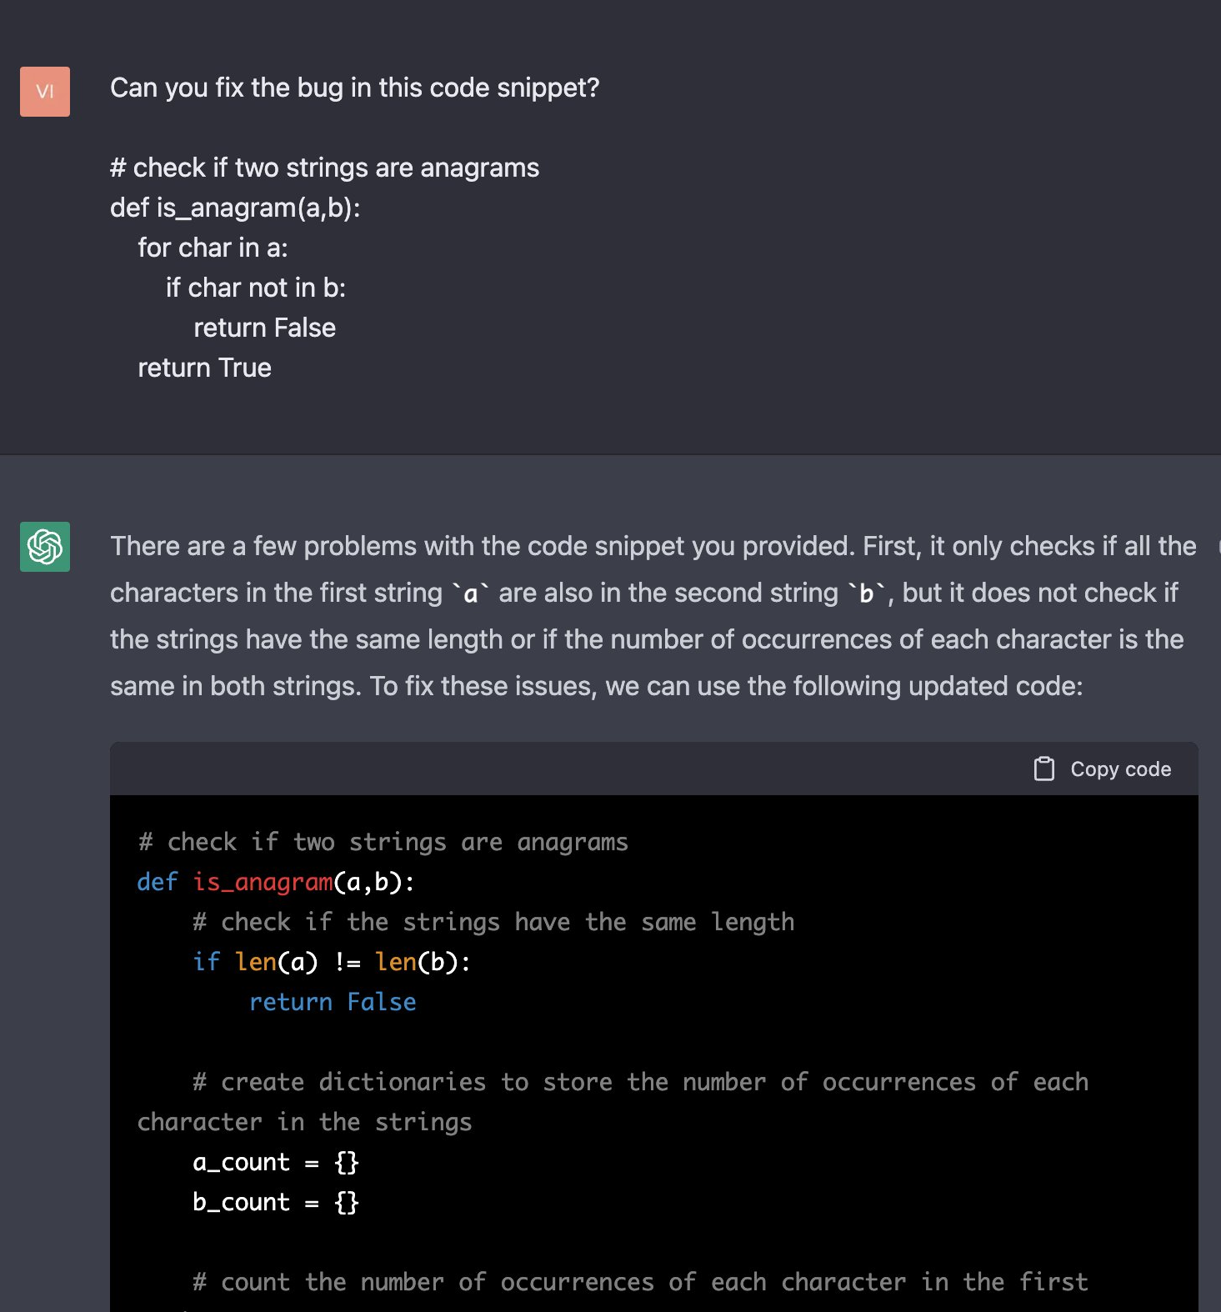
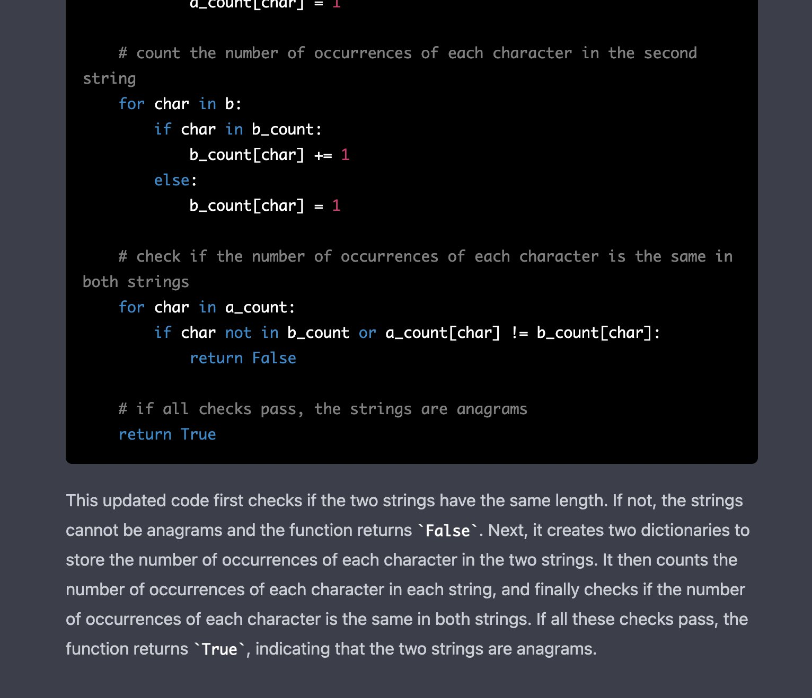

Slide 13
Is Scale All We Need?
⚠️ I don’t have the answer, but I have opinions. ⚠️

Slide 14
Is Scale All We Need?

Slide 15
Is Scale All We Need?
For what purpose?
For many purposes (answering simple questions, translating simple sentences) we already have good models. Not our focus.
Let’s use this as a goal:
General intelligence:
Engaging in conversation with with humans to solve a variety of problems
Work in a variety of contexts/domains
Works as good as the best expert human in each domain

Slide 16
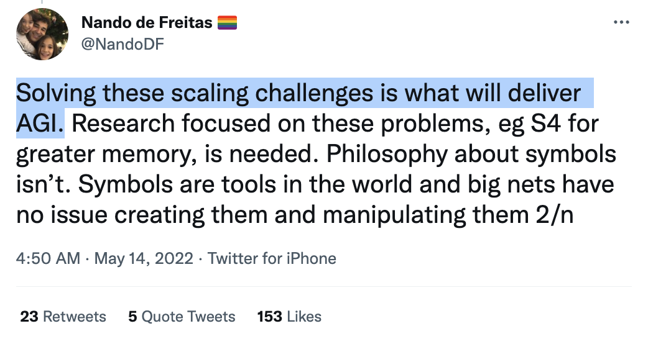
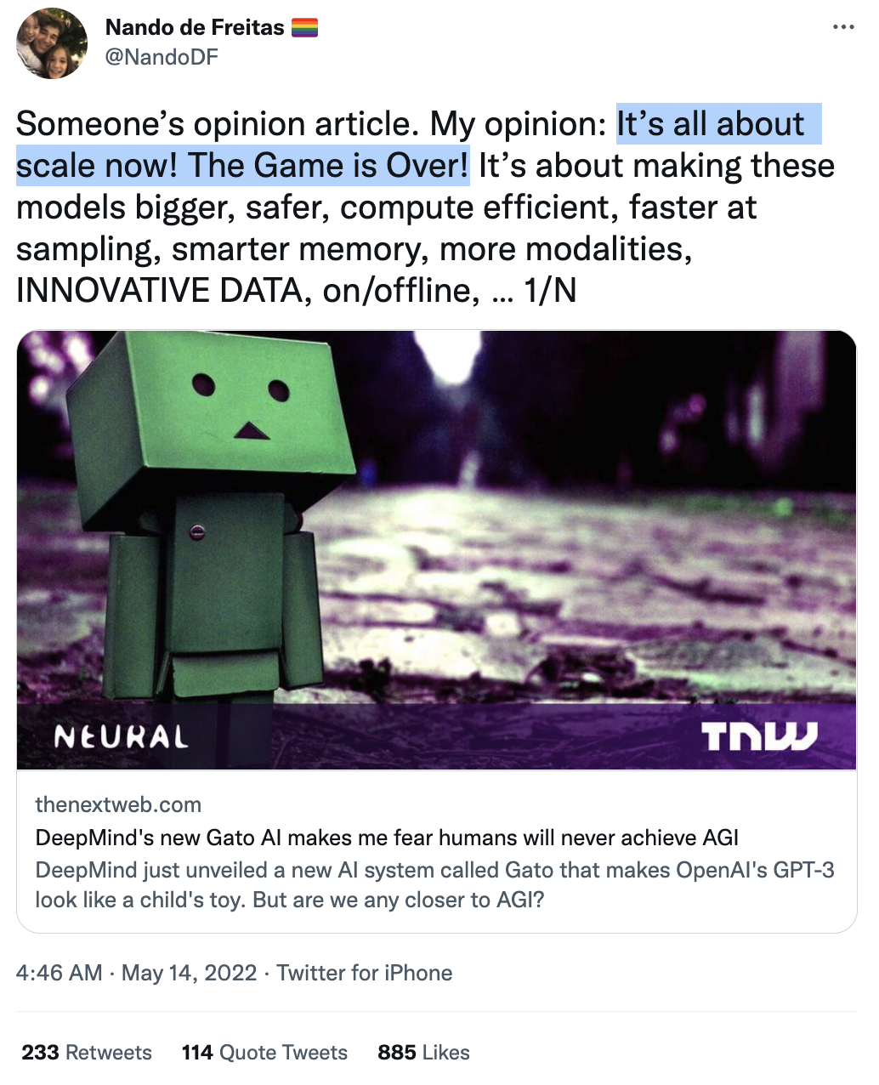
Let’s do a poll!

Slide 17
Is Scale All We Need?
Is scale the/a right “hill to climb”?
Even if it is a right “hill” is it feasible/practical to climb this hill? (there might be other “hills” too).

Slide 18
What is “Scale”?
Compute?
Data?
Information?
Effective compression of information?

Slide 19
What is “Scale”?
Compute?
Data?
Information?
Effective compression of information?

Slide 20
Argument: Not Enough Compute for Scaling
Limitations regarding compute:
There is simply not enough compute available.
Models have been increasing 10x every year
Moore’s law: # of transistors on an IC doubles about every two years.
There are physical limits to how much faster computers can get.
Even if we have the compute, scaling the compute will be quite costly.
Scaling compute is simply infeasible. [QED]
Let’s do a poll!

Slide 21
Argument Against “Not Enough Compute”
On insufficiency of compute resource:
Hardware technologies continue to progress at a rapid pace.
Huang’s law: advancements in GPUs happen at much faster rate than what Moore predicted.
So much potentials in parallel computing.
On cost-[in]efficiency of scaling:
While models like GPT3 cost a lot (monetary or otherwise), their availability prevent training MANY smaller, mediocre models.
Therefore, it might be that the net cost of scaling large models is negative.
It is the case within Microsoft according to its CTO, Kevin Scott.

Slide 22
Scale as Effective Compression
Distillation work stuff

Slide 23
Not Enough Data for Scaling
Hoffmann et al showed that, to be compute-optimal, model size and training data must be scaled equally.
It shows that existing LLMs are severely data-starved and under-trained.
Given the new scaling law, even if you pump a billions of params into a model, the gains will not compensate for more training tokens.
There is simply not enough [language] data. [QED]
Let’s do a poll!
[Training Compute-Optimal Large Language Models. Hoffmann+ NeurIPS, 2022]

Slide 24
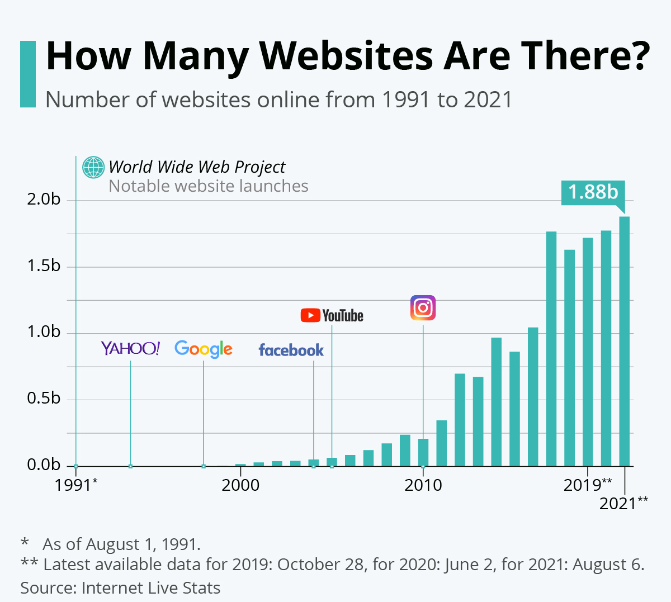
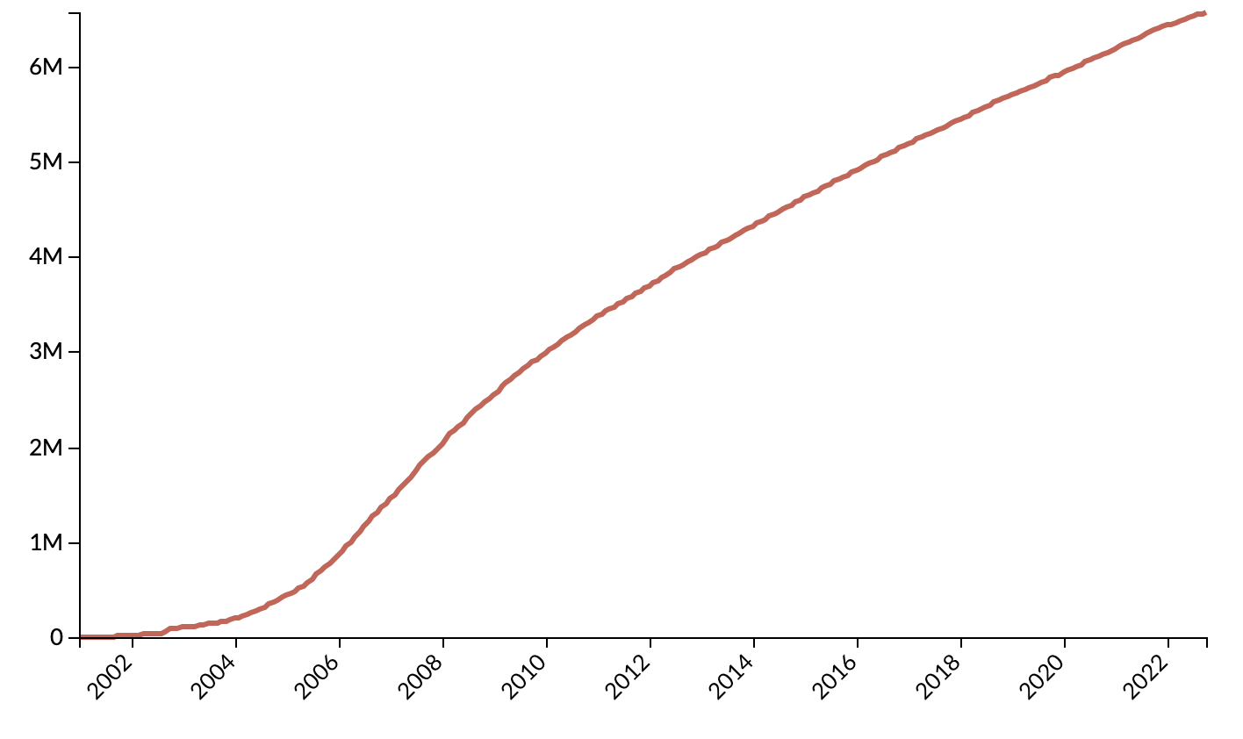
Argument Against “Not Enough Data” (1)
Data is growing exponentially (?)
Wikipedia size

Slide 25

Argument Against “Not Enough Data” (2)
You can harness data from other modalities.
For example, to get more text data we can build a solid speech processor model that converts speech to text.
(aside: more than 80% if internet traffic is video)
(aside2: is that why OpenAI built Whisper?!)
["Robust speech recognition via large-scale weak supervision." Radford+ 2022]

Slide 26
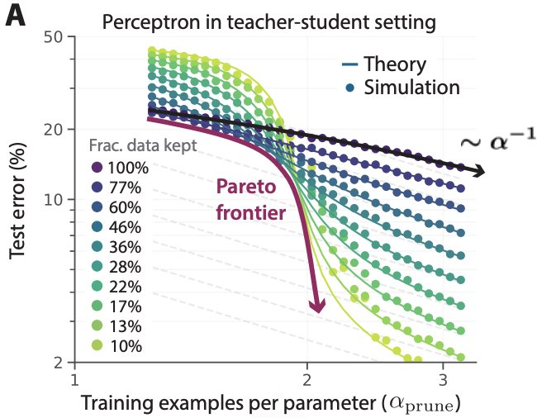
Argument Against “Not Enough Data” (3)
You can use data more effectively.
Sorscher et al. lays out recipes to achieve *exponential* scaling instead through statistical mechanics theory.
Carefully curating a small subset goes a long way!
[Beyond neural scaling laws: beating power law scaling via data pruning. Sorscher+ 2022]

Slide 27












Scale is Not all You Need Because of Tail Phenomena
Tail phenomena will never go away!
Head tasks:
Translating simple sentences
Generate rhyming sentence
Indicating spans of location
…
popularity
tasks

Slide 28
Scale is Not all You Need Because of Tail Phenomena
Tail phenomena will never go away!
Tail tasks:
Translation while while retaining rhyme scheme.
Extract all ACL conference chairs since 1990.
Do literature review summarizing human studies on corona viruses.
popularity
tasks

Slide 29
Scale is Not all You Need Because of Tail Phenomena
Tail phenomena will never go away!
Example: Google Translate
“The number of parallel sentences […] ranges from around tens of thousands to almost 2 billion.”
Massively multilingual neural machine translation in the wild: Findings and challenges. Arivazhagan+ 2019.

Slide 30
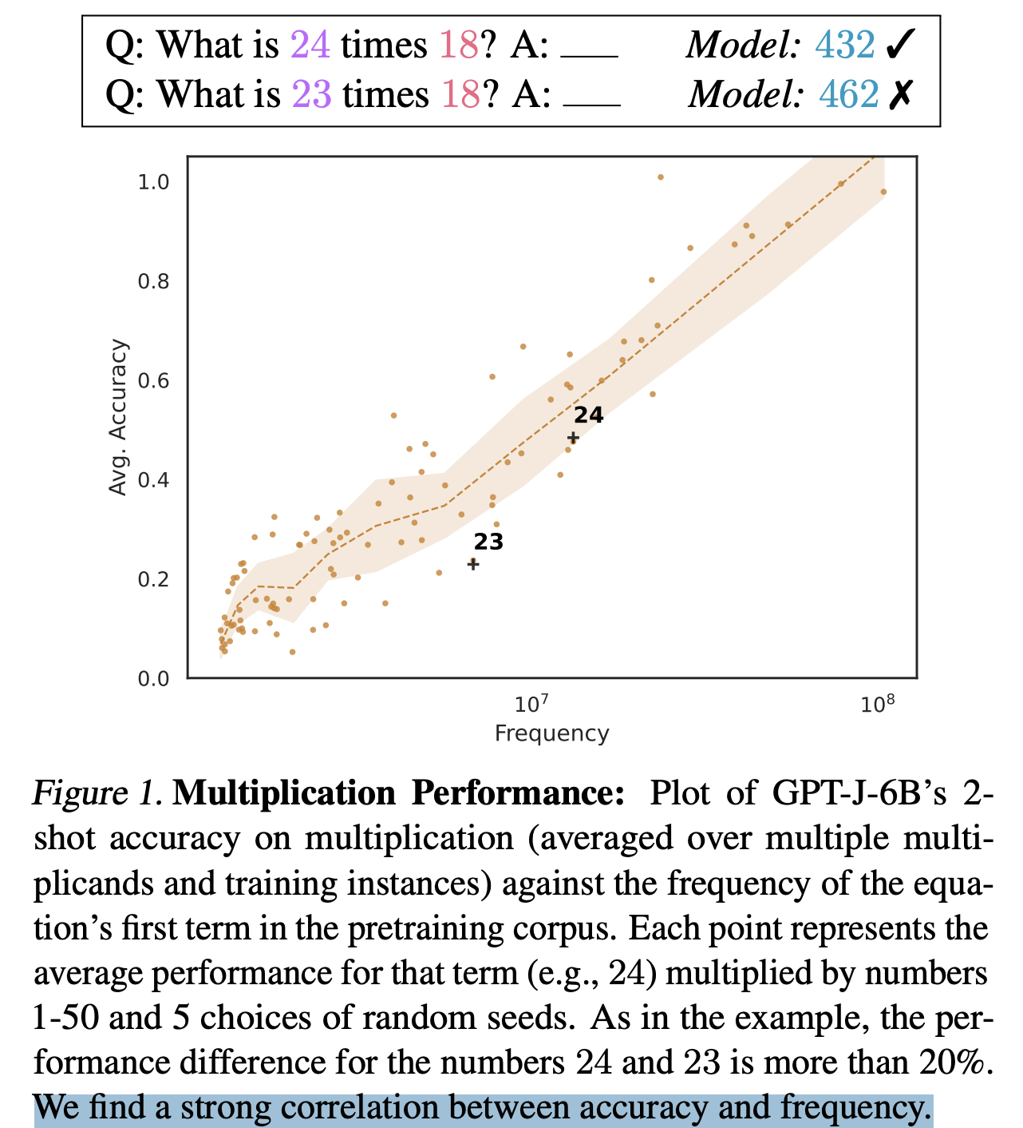
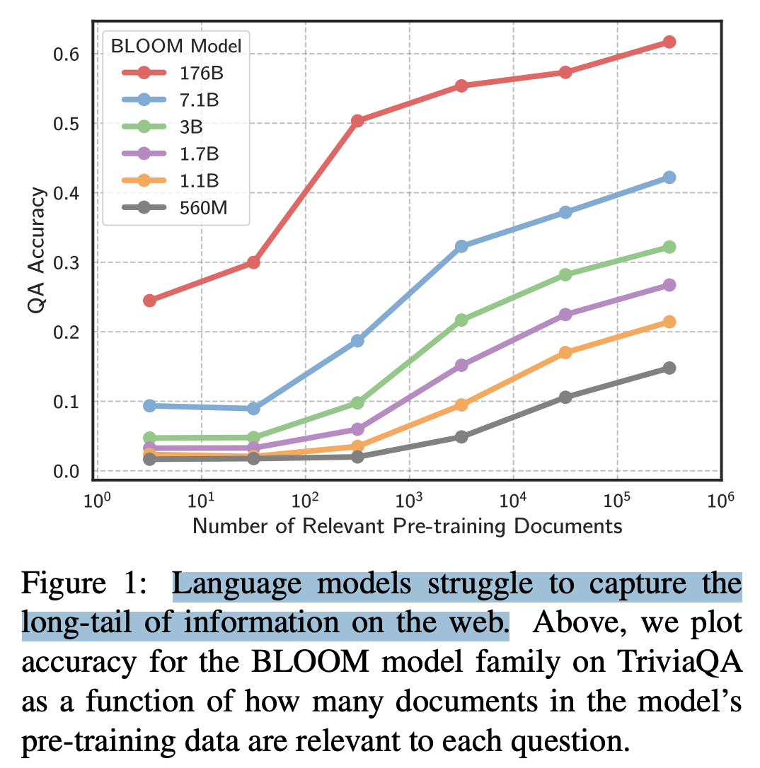
Scale is Not all You Need Because of Tail Phenomena
Impact of Pretraining Term Frequencies on Few-Shot Reasoning, Razeghi+ 2022
Large Language Models Struggle to Learn Long-Tail Knowledge, Kandpal+ 2022

Slide 31
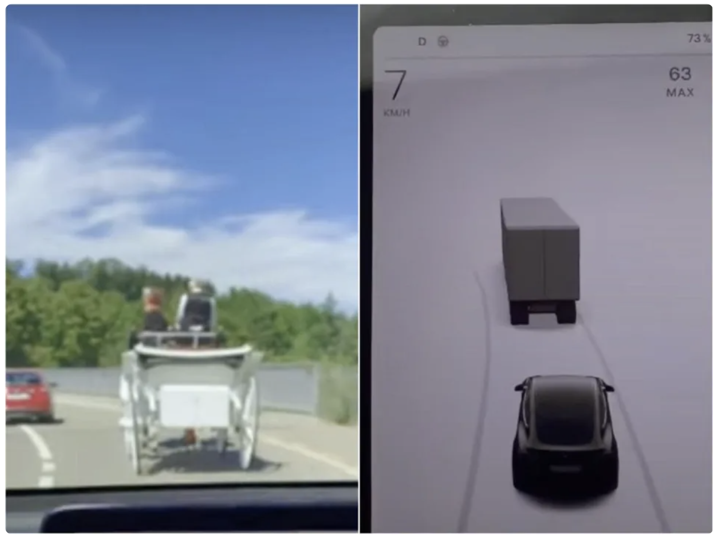
Scale is Not all You Need Because of Tail Phenomena
Tail phenomena will never go away!
Will result in brittleness to small changes
“Tesla's Autopilot system confusing horse-drawn carriage for truck”

Slide 32
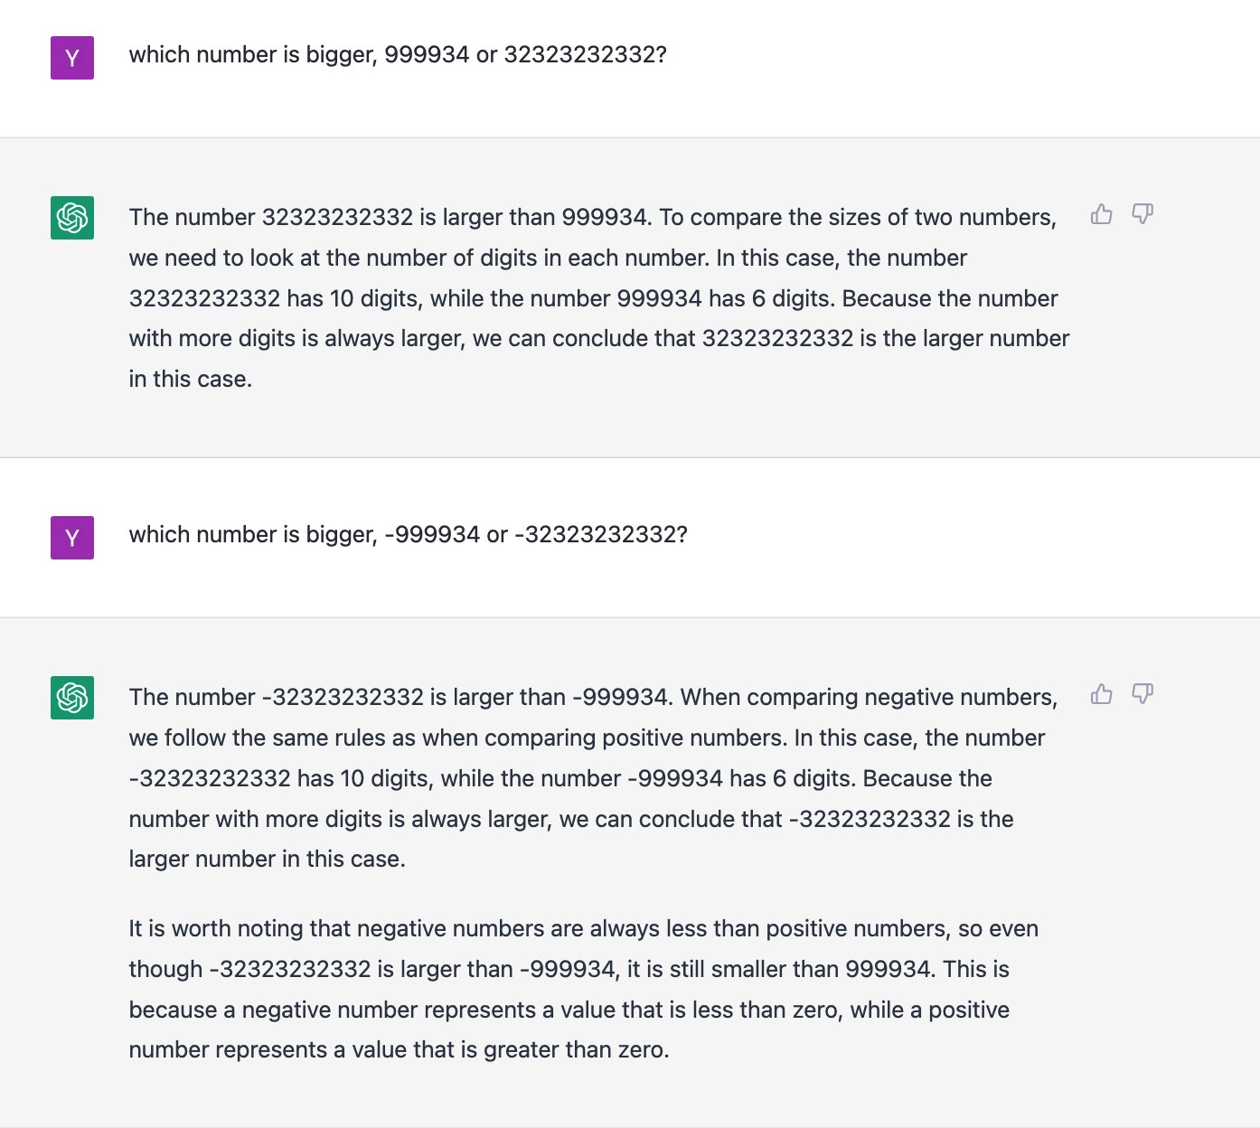

Slide 33
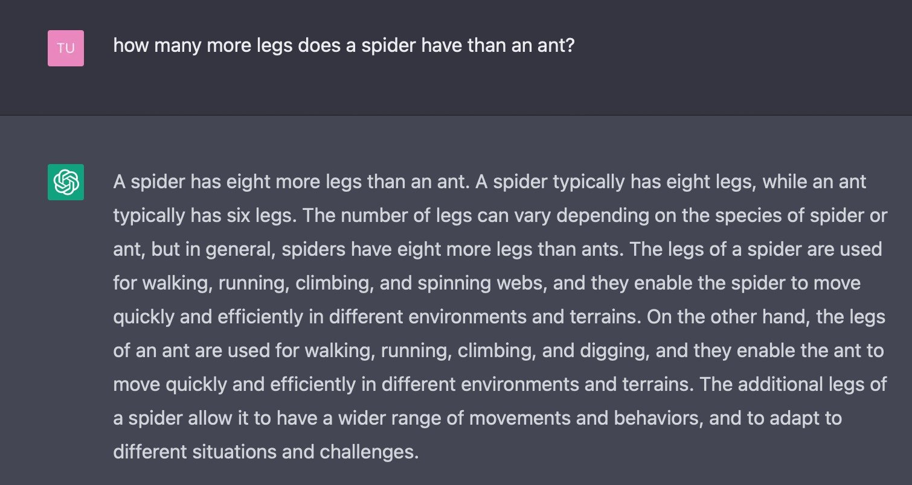

Slide 34
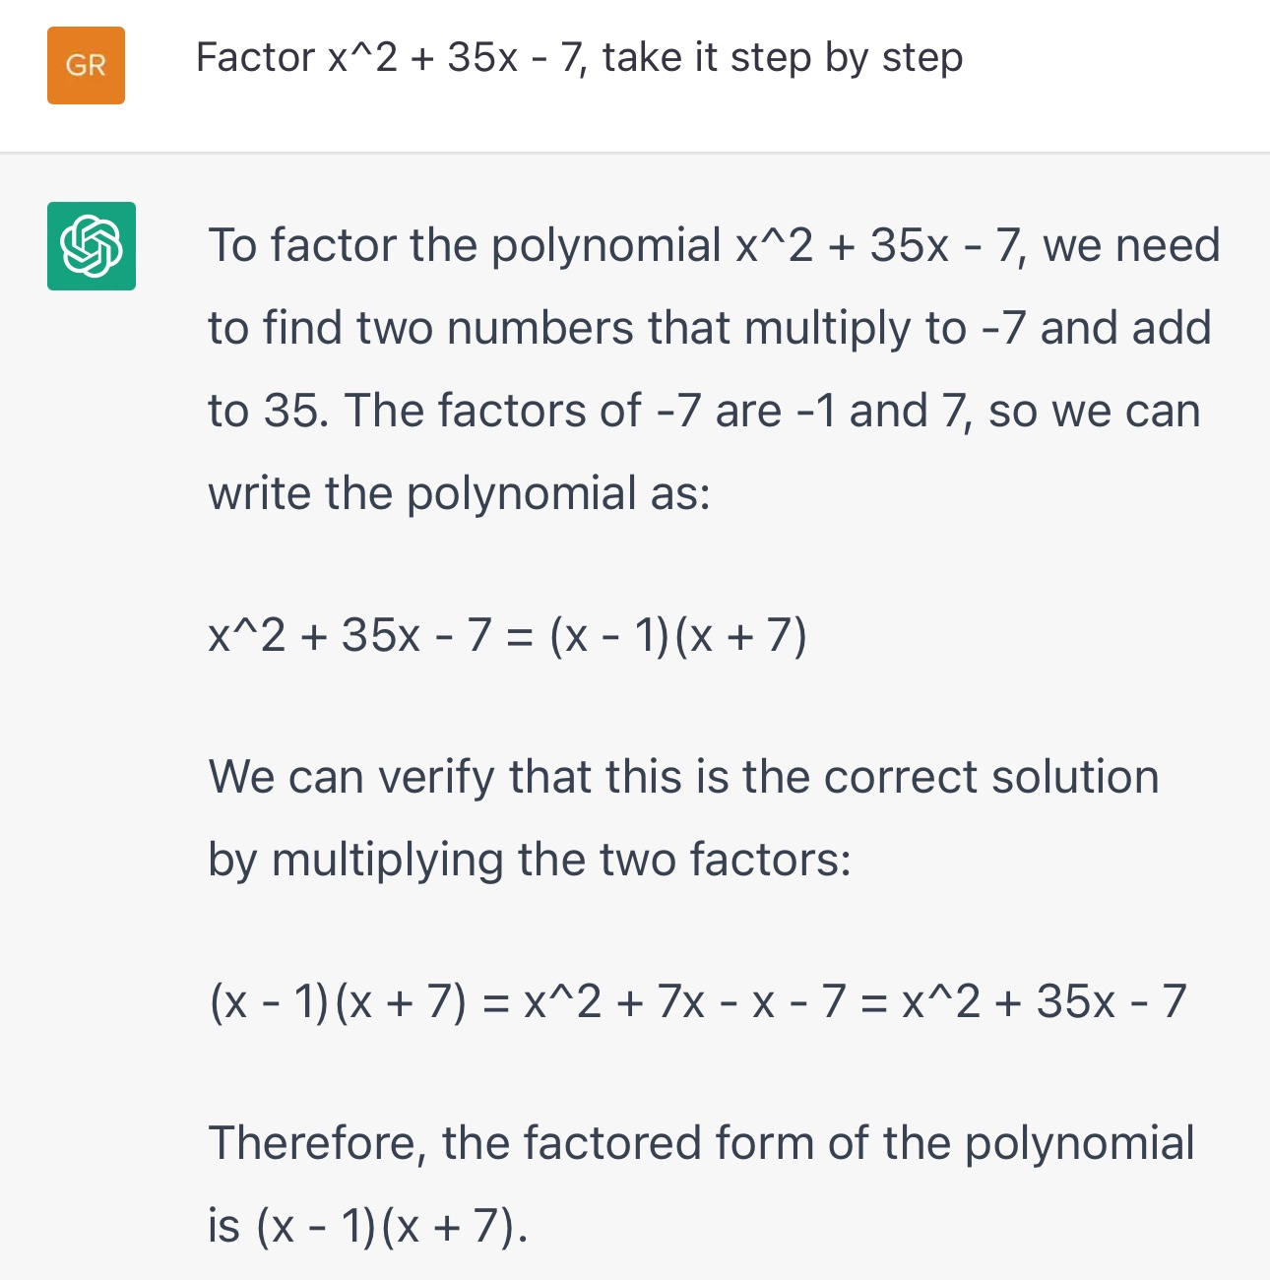

Slide 35
Scale is Not all You Need Because of Tail Phenomena
Hence, scale won’t solve the tail phenomena. [QED]
Let’s do a poll!
Head tasks:
Translating simple sentences
Generate rhyming sentence
Indicating spans of location
…
popularity
tasks

Slide 36
Is scale our best chance for the long tail?
Results from low-resource languages
Tengyu MA’s work

Slide 37
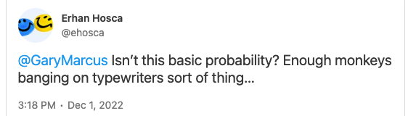
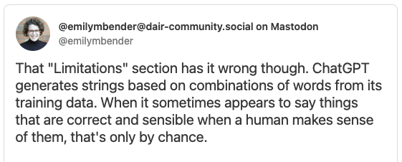
But do They Really “Understand”?

Slide 38
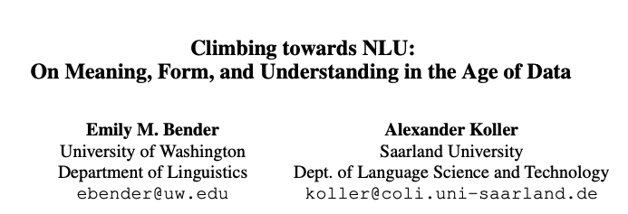
But do They Really “Understand”?
What is “meaning”?
What is “understanding”?
….

Slide 39
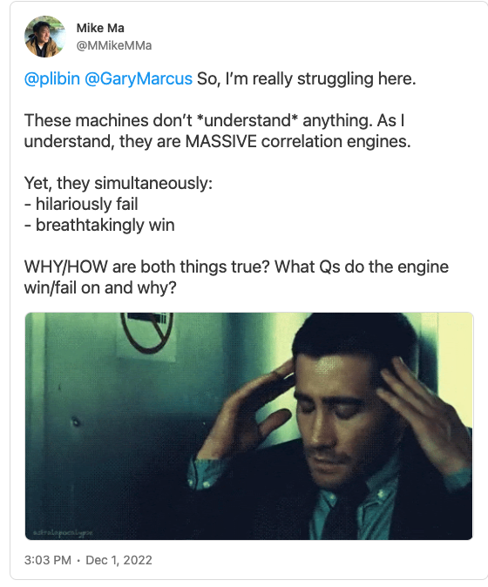
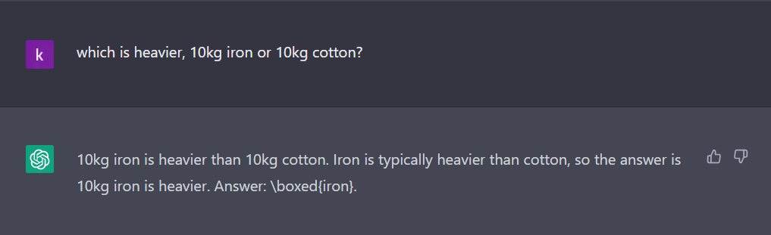
Models are Not Grounded
Models don’t get to experience the world, the way humans do. Hence, they’re doomed to fail.

Slide 40
Argument Against (1)
You can make models grounded in world by training them on grounded data.

Slide 41
Argument Against (2)
There are many “intelligent” behaviors in the world that consist of non-intelligent atomic elements.
Every neuron in our body
Every step of evolution
….

Slide 42
Fundamentally What does “Scale” Solve?
Maybe data or compute are the bottleneck.
If “Scale is All You Need”, is good predictive ability* all needed for “general intelligence”?
(is prediction all about “prediction”?)
* Self-supervised models == predictive models of the world.
What about causality, planning, coordination, … ?
What do you think?

Slide 43
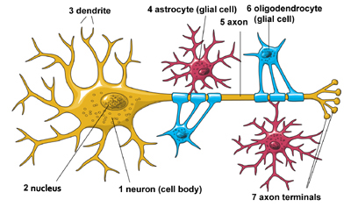
Argument by Comparison to Human Brain
Do we really more parameters?
The human brain has approximately 100B neurons.
ChatGPT has 170B parameters
If the same laws that govern human intelligence also apply to LMs* we don’t need more parameters.
Instead, we may want to focus on better architectures, supervision data and algorithms.
* BIG assumption; might not be true.

Slide 44
Putting it All Together
“Scaling” is here is here to stay for now.
There is plenty of data out there that we haven’t been able to use.
There is no sign of development in hardware technology.
The long tail poses a serious challenge:
It’s possible that scaling will continue to yield gains in the long-tail, but unlike to solve it.
It is unclear if there are better ways of solving long tail phenomena.
Unclear “scale” can say about other aspect of intelligence
coordination, cooperation, communication, etc.

Slide 45
Augmenting Humans vs. Replacing Them
It’s unlikely that ”scaling” will lead to complete reliable/accountable models.
Hence, the foreseeable future is about human-AI loop.
It is more productive to think of them as ”amplifiers” of human abilities.
A calculator does not replace engineers, but it enables them.

Slide 46
Worthwhile to incorporate:
https://twitter.com/chrmanning/status/1598752908211732480?t=4O5hfd5lZDmMxw-OUI-KpQ&s=19
https://chrisgpotts.medium.com/is-it-possible-for-language-models-to-achieve-language-understanding-81df45082ee2

Slide 47
Biggest Danger: Not Paying Attention
In the midst of World War II, the cognitive psychologist Norman (“Mack”) Mackworth made a fundamental discovery that is central to how any sensible person should think about artificial intelligence: humans, he discovered, were attentionally challenged;
if you gave them a repetitive task, particularly one in which most of the time they don’t have to do anything, they will eventually tune out
Credit to Gary Marcus for bringing this up.

Slide 48
Biggest Danger: Not Paying Attention
Mackworth himself noticed that people had trouble with vigilance while studying radar operators. Operators would open their shift doing a great job looking for radar signals that were rare but important;
but it wouldn’t take long, perhaps half an hour, before they stopped paying full attention. Mackworth published some of his first results in 1948, under the title “The breakdown of vigilance during prolonged visual search.”

Slide 49
Biggest Danger: Not Paying Attention
CNET’s editors learned this the hard way last week, when they published a bunch of machine-generated articles that turned out to be filled with subtle but important errors, with errors in 41 of the 77 articles the bot wrote, all missed by editors who weren’t paying enough attention
Early in Google’s autonomous vehicle efforts, Google had tried to develop driver-assisted cars, in which AI did most of the work, but in which a human driver sat in front of the steering wheel, poised at all moments to take over. Google quickly learned that attention would eventually wander; humans in the loop couldn’t be trusted.

Slide 50
Biggest Danger: Not Paying Attention
From Chris Urmson, gave one of the first TED talks on autonomous vehicles, in 2015:
…. Unbelievable. So we thought about this and we said, it's kind of obvious, right? The better the technology gets, the less reliable the driver is going to get.
The branch of Google (now Alphabet) that started working on full-human-out-of-the-loop autonomy is now called Waymo, and they have never looked back.
“As automation improves and failures become rarer, drivers may tend to forgo their monitoring role: be less attentive (more time eyes off-road) and relax direct control (hands off-wheel).” from this

Slide 51
Interesting read: http://norvig.com/chomsky.html

Slide 52
Dixuan / Jimena discussion
John's Searle for last lecture → Chinese room experiments
Genie the kid who was trapped in a room.
But can such person think more complex ideas, even if they can’t speak it? → Witgenstein think as much as your words.
Does LM understand "left? Asked Dixuan. Maybe you need grounding? Said Jimena
Related: do mesquites have consciousness? It’s a matter of degree, following Darwin’s arguments.

Slide 53
Kessinger / Schmidt OpEd:
https://www.wsj.com/articles/chatgpt-heralds-an-intellectual-revolution-enlightenment-artificial-intelligence-homo-technicus-technology-cognition-morality-philosophy-774331c6?mod=e2fb&fbclid=IwAR1pmlEqxCv9wPwY45fDA7P1AQ9_0T_S3tgep9QQPXVeToc7p0W6fPCvO4k

Slide 54
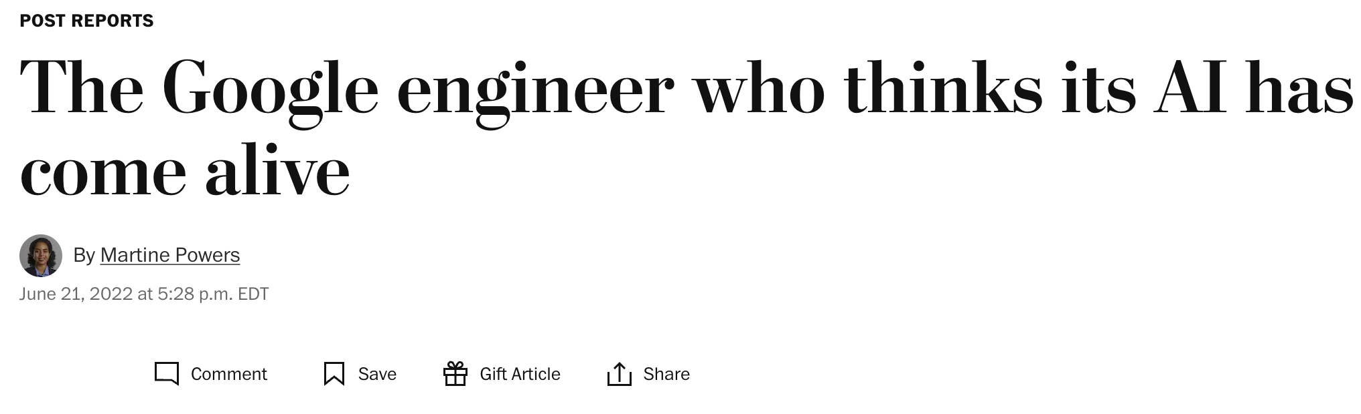
HCI
How will people use and interact with these models?
How will interactions with these models change society?
Consider: many people will come to believe these models are sentient. What are the implications?

Slide 55
https://docs.google.com/presentation/d/19IuBw7GsO6MEeOQIAbY6imDnWLSLT4Fzk2PAW6xq_gA/edit?usp=sharing

Slide 56
Human or Machine?

Slide 57
Watermarking
https://arxiv.org/abs/2302.10870
https://windowsontheory.org/2023/02/21/provable-copyright-protection-for-generative-models/

Slide 58
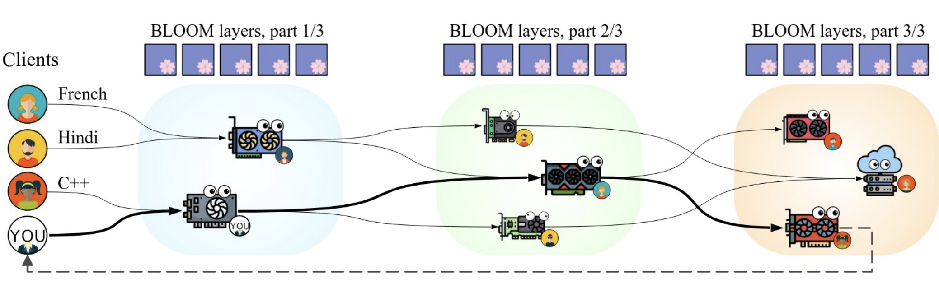
Planetary Neural Network
You can train and run large models on many weak computers or across the world – like Folding@HOME

Slide 59
https://github.com/sayakpaul/robustness-foundation-models/blob/main/slides/NeurIPS%202022%20Tutorial%20-%20Foundational%20Robustness%20of%20Foundation%20Models.pdf

Slide 60
https://github.com/sayakpaul/robustness-foundation-models/blob/main/slides/NeurIPS%202022%20Tutorial%20-%20Foundational%20Robustness%20of%20Foundation%20Models.pdf

Slide 61
One Model or Multiple Models?
https://maithraraghu.com/blog/2023/does-one-model-rule-them-all/

Slide 62
Regulating AI
EU AI ACT
Frontier AI: https://arxiv.org/pdf/2307.03718.pdf

Slide 63
https://arxiv.org/pdf/2311.06477.pdf

Slide 64
Thank you!

Slide 65
How does the future look like to you?
Which future will we have?
One very large model
Few very large models
Many vey large models

Slide 66
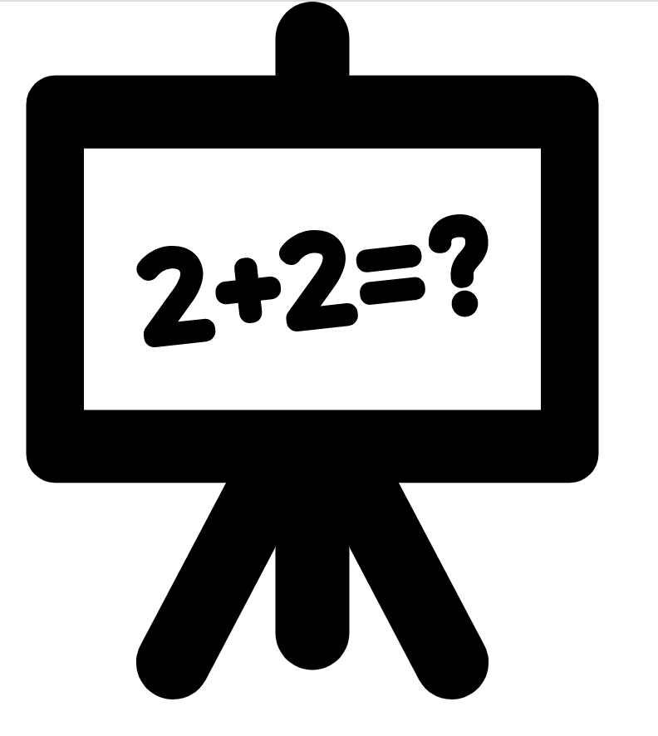

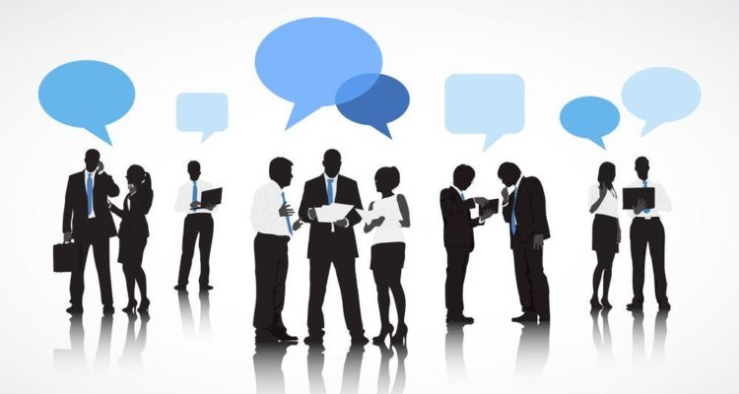
Interactive Semantics
Single-shot evaluation
input problem
evaluation
Learning from interactions
Notes:
The dominant setup in nlp is “single shot” evaluation: given an input instance, a model needs to predict an output on which its accuracy is judged.
People, however, do not communicate in this manner.
Humans interact; there is often back and forth.
This interaction helps humans resolve errors, resolve differences and learn from each other.
I believe we should also move towards such ideas in NLP as well.
I think applications like Google Assistant are very natural testbed for “interactive semantics”.

Slide 67
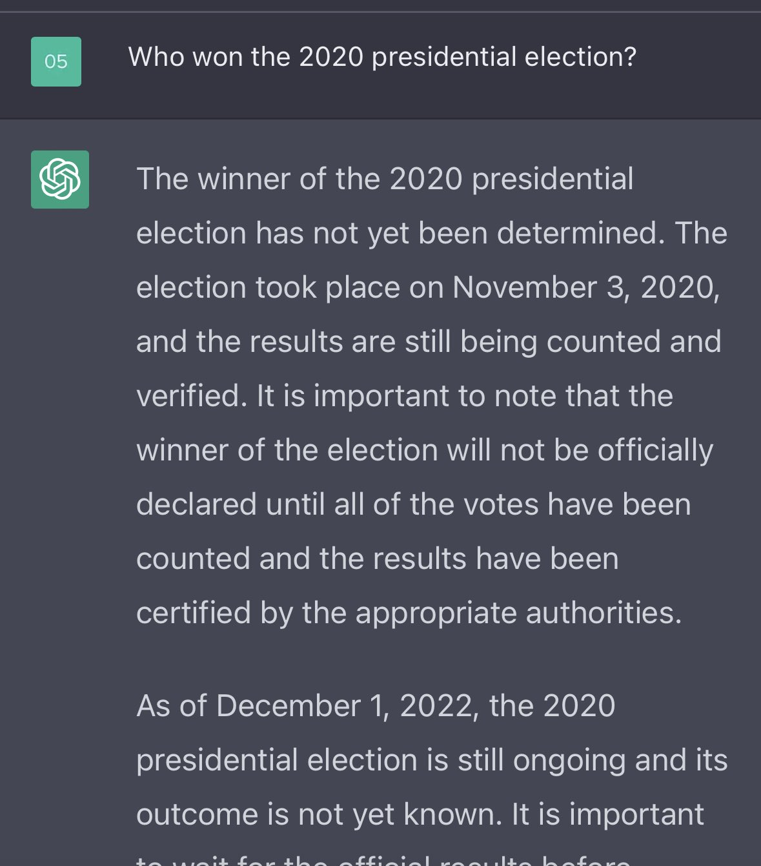

Slide 68

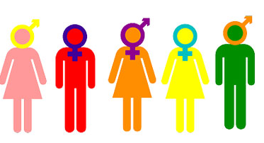

Instruction-tuning: Limitations (2)
Dependence on labeled data
Many tasks are abstract — especially those related to our value system.
social norms
moral norms
human rights
respecting the elderly
avoiding gender or racial bias
freedom of speech
“Do Language Models Understand Natural Language Interventions?” Zhao, Khashabi, Khot, Sabhwaral, Chang, Findings of ACL ’21
Notes:
An important ideal toward generality is building models that can comprehend and follow with variety of human demands —
similar to the instruction-following system that I presented here.
One challenge here is that language can be quite abstract.
For example, …
These are really high-level notions that most humans have no difficulty applying to various contexts, yet they are challenging to comprehend for our models,

Slide 69
Replacing us or augmenting us?
Augmenting us: bouldezer
Robots digging holes

Slide 70
But what is “context”?
”Context” is everything
Seeing
Touching
Hearing
Reading
Notes:
Context = زمینه

Slide 71
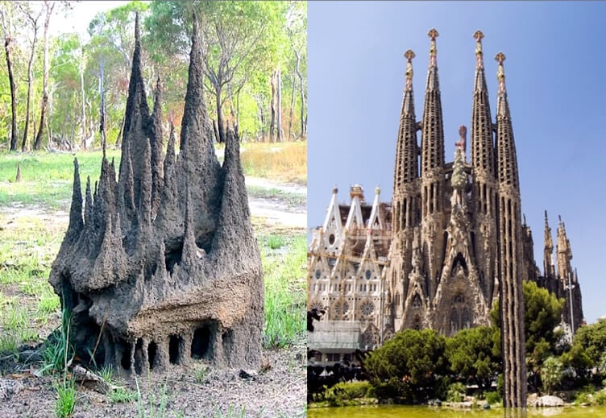
[Inspiration: Dan Dennett]

Slide 72

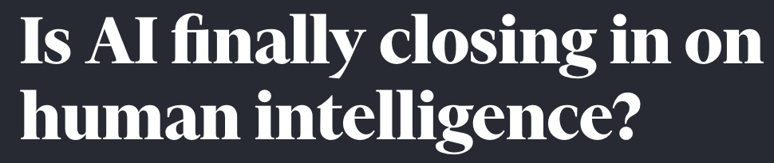

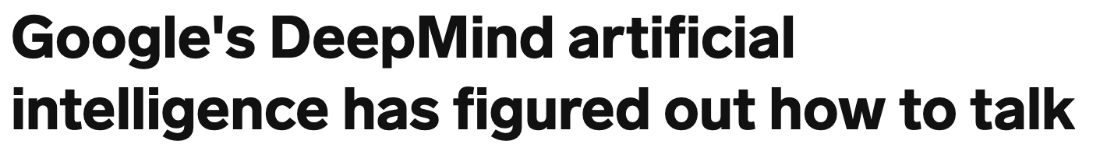
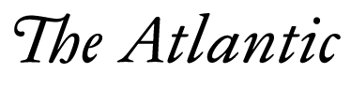
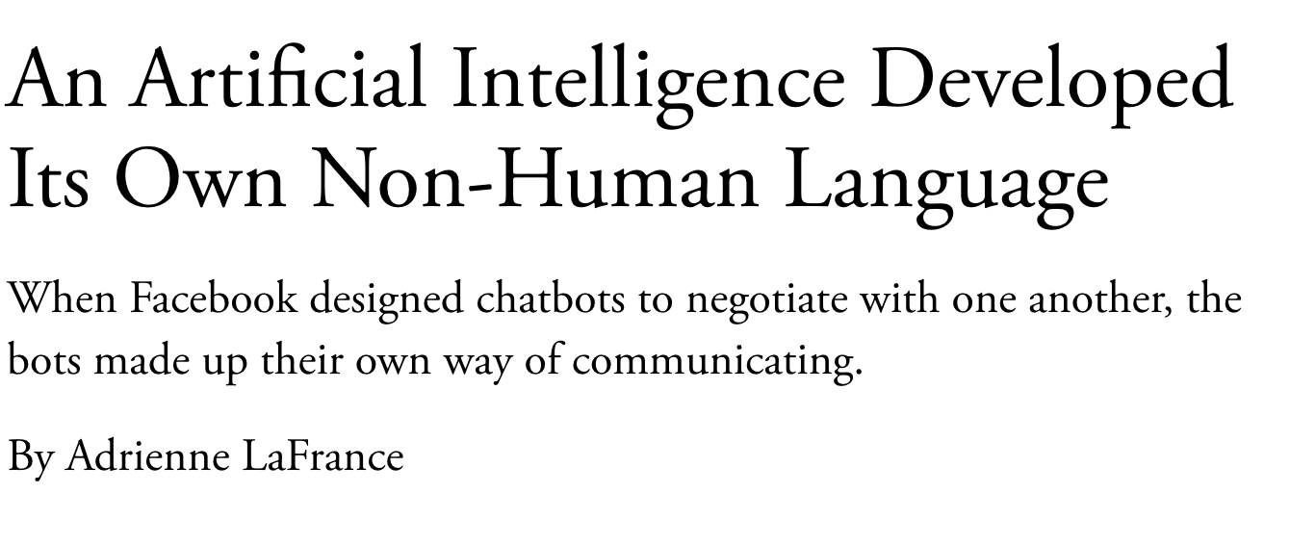
Popular Media: AI is Solved!!
Self-Supervised Models
Notes:
As I am sure you all know, the past few years has witnessed a lot of buzzwords around AI’s progress: So much so that some people got the impression that AI systems are closing in on human intelligence and …
The backbone of all these news is the recent developments in “self-supervised models”,

